Slide 1
Bandstand
June 2022

Slide 2
Sing From Your Heart
There’s a song that’s living deep inside me,
There’s a voice that’s longing to be set free,
I’ve got to find it now, I gotta give all I’ve got.
Gonna lose myself inside the music,
gonna feel the rhythm, gonna use it,
This is the chance I have to take, this is my shot.
Shake off your doubt, what’s within, let it out.
Sing from your heart with all of your power.
Sing with a fire that knows no fear.
Sing with your voice your, song for the world to hear.
I may be one but I am one of many
and we can make a sound as big as any
and if we rise as one, I know that we’re gonna shine.
I may be young, but I am getting stronger.
I got a dream that won’t wait any longer,
a feeling in my bones that’s saying: ‘This is my time’.
Shake off your doubt, what’s within, let it out.
Sing from your heart with all of your power.
Sing with a fire that knows no fear.
Sing with your voice your, song for the world to hear.

Slide 3
Sing from your heart with all of your power.
Sing with a fire that knows no fear.
Sing with your voice your, song for the world to hear.
There’s a light inside, light inside, light inside,
There’s a light inside, light inside, light inside.
PART 1
Sing from your heart. Sing with a fire. Sing with your voice. Sing from your heart. Sing with a fire. Sing with your voice.
PART 2
There’s a light inside, light inside, light inside.
There’s a light inside, light inside, light inside of you.
Sing from your heart, with all of your power,
Sing with a fire that knows no fear,
Sing with your voice your song for the world to hear.
Sing from your heart, with all of your power,
Sing with a fire that knows no fear,
Sing with your voice your song for the world to hear,
your song for the world to hear.

Slide 4
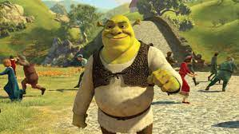
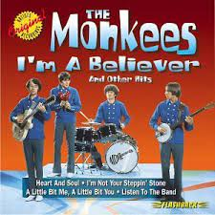
I’m a Believer
60s
I thought love was only true in fairytales,
Meant for someone else but not for me.
Love was out to get me,
that’s the way it seems.
Disappointment haunted all my dreams.
Then I saw her face, now I’m a believer.
Not a trace of doubt in my mind.
I’m in love
I’m a believer!
I couldn’t leave her if I tried.
I thought love was more or less a given thing,
Seems the more I have the less I got.
What’s the use of trying?
All you get is pain.
When I needed sunshine I got rain.
Then I saw her face, now I’m a believer.
Not a trace of doubt in my mind.
I’m in love
I’m a believer!
I couldn’t leave her if I tried.
Love was out to get me,
that’s the way it seems.
Disappointment haunted all my dreams.
Then I saw her face, now I’m a believer.
Not a trace of doubt in my mind.
I’m in love
I’m a believer!
I couldn’t leave her if I tried.
Then I saw her face, now I’m a believer.
Not a trace of doubt in my mind.
Yeah, I’m a believer.
Yeah, I’m a believer.

Slide 5
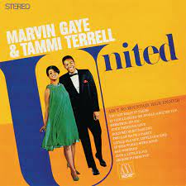
Ain’t No Mountain
60s
Remember the day,
You set me free,
I told you you could
Always count on me.
From that day on,
I made a vow,
I’ll be there when you want me,
Somewhere, somehow.
’Cos baby there
Ain’t no mountain high enough,
Ain’t no valley low enough,
Ain’t no river wide enough
To keep me from getting to you, babe,
To keep me from getting to you!
If you need me, call me,
No matter where you are,
No matter how far,
Don’t worry, brother.
Just call out my name,
I’ll be there in a hurry,
You don’t have to worry,
’Cos baby there
Ain’t no mountain high enough,
Ain’t no valley low enough,
Ain’t no river wide enough
To keep me from getting to you, babe.

Slide 6
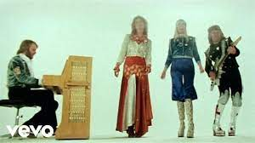
Waterloo – Mamma Mia
70s
ABBA - Waterloo (Karaoke Version) - YouTube
My, my
At Waterloo Napoleon did surrender
Oh yeah
And I have met my destiny in quite a similar way
The history book on the shelf Is always repeating itself
Waterloo
I was defeated, you won the war
Waterloo
Promise to love you for ever more
Waterloo
Couldn't escape if I wanted to
Waterloo
Knowing my fate is to be with you
Woah woah woah woah Waterloo
Finally facing my Waterloo
My, my
I tried to hold you back but you were stronger
Oh yeah
And now it seems my only chance is giving up the fight
And how could I ever refuse
I feel like I win when I lose
Waterloo
I was defeated, you won the war
Waterloo
Promise to love you for ever more
Waterloo
Couldn't escape if I wanted to
Waterloo
Knowing my fate is to be with you
Woah woah woah woah Waterloo
Finally facing my Waterloo

Slide 7
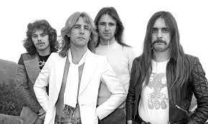
Rockin’ All Over the World
70s
Well here we are and here we are and here we go,
On and on, an’ we’re hittin’ the road,
Here we go,
Rockin’ all over the world.
Well giddy up and giddy up and get away,
We’re going crazy and we’re going today,
Here we go,
Rockin’ all over the world.
An’ I like it, I like it,
I like it, I like it,
I la la la like it, La la la like,
Here we go,
Rockin’ all over the world.
We’re gonna tell your mama what you’re gonna do,
So come on out and get your dancin’ shoes,
Here we go,
Rockin’ all over the world.
An’ I like it, I like it,
I like it, I like it,
I la la la like it, La la la like,
Here we go,
Rockin’ all over the world.
(Repeat chorus x 3)
Yeah!

Slide 8
Video Killed the Radio Star
80s
I heard you on my wireless back in fifty two
Lying awake intent at tuning in on you
If I was young it didn't stop you coming through
oh-wa-oh-wa
They took the credit for your second symphony
Rewritten by machine and new technology
And now I understand the problems you can see
oh-wa-oh-wa
I met your children
oh-wa-oh-wa
What did you tell them?
Video killed the radio star
Video killed the radio star
Pictures came and broke your heart,
Oh - aoh – oh - oh – oh

Slide 9

And now we meet in an abandoned studio
We hear the playback and it seems so long ago
And you remember, the jingles used to go,
oh-wa-oh-wa
You were the first one
oh-wa-oh-wa
You were the last one
Video killed the radio star
Video killed the radio star
In my mind and in my car,
we can't rewind we've gone too far
Oh - aoh – oh - oh – oh
Oh – aoh – oh - oh – oh
Video killed the radio star
Video killed the radio star
In my mind and in my car,
we can't rewind we've gone too far
Pictures came and broke your heart
Put all the blame on V.C.R.

Slide 10
Can’t Stop the Feeling
10s
I got this feeling inside my bones.
It goes electric, wavy when I turn it on.
All through my city, all through my home,
We're flying up, no ceiling, when we're in our zone.
I got that sunshine in my pocket,
Got that good soul in my feet.
Feel that hot blood in my body when it drops. (Ooh)
I can't take my eyes up off it, moving so phenomenally.
Room on lock the way we rock it, so don't stop.
And under the lights when ev’rything goes.
Nowhere to hide when I'm getting you close.
When we move, well, you already know,
So just imagine. (just imagine, just imagine)
Nothing I can see but you when you dance, dance, dance,
Feeling good, good, creeping up on you: dance, dance, dance,
All those things I shouldn't do but you dance, dance, dance.
Ain't nobody leaving soon so keep dancing. (I can't stop the feeling.)
So just dance, dance, dance,(I can't stop the feeling.)
So just dance, dance, dance, come on!

Slide 11
Ooh, something magical,
It's in the air, it's in my blood, it's rushing on.
Don't need no reason, don't need control,
I fly so high, no ceiling, when I'm in my zone.
'Cos I got that sunshine in my pocket,
Got that good soul in my feet
Feel that hot blood in my body when it drops. (Ooh)
I can't take my eyes up off it, moving so phenomenally.
Room on lock the way we rock it, so don't stop.
And under the lights when ev’rything goes.
Nowhere to hide when I'm getting you close.
When we move, well, you already know,
So just imagine. (just imagine, just imagine)
Nothing I can see but you when you dance, dance, dance,
Feeling good, good, creeping up on you: dance, dance, dance,
All those things I shouldn't do but you dance, dance, dance,
Ain't nobody leaving soon so keep dancing. (I can't stop the feeling.)
So just dance, dance, dance, (I can't stop the feeling.)
So just dance, dance, dance, come on! (I can't stop the feeling.)
So just dance, dance, dance, (I can't stop the feeling.)
So keep dancing.

Slide 12
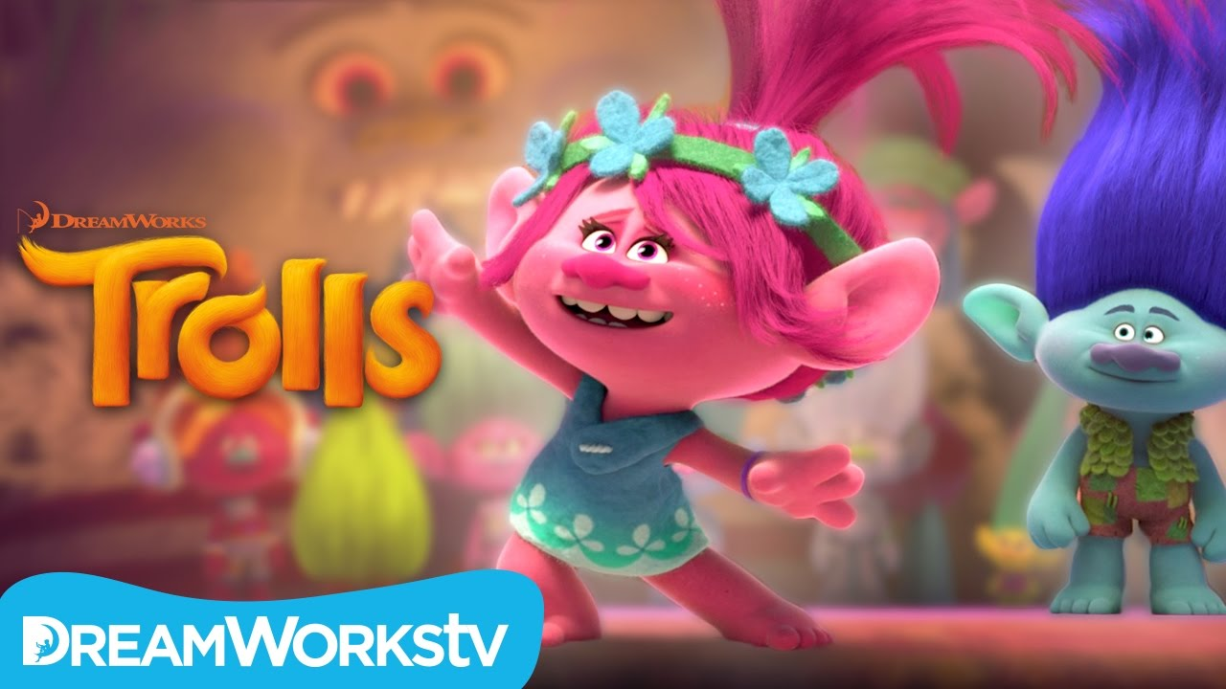

Can’t stop the, (x4) (I can't stop the feeling.)
Nothing I can see but you when you dance, dance, dance, (I can't stop the feeling.)
Feeling good, good, creeping up on you: dance, dance, dance, (I can't stop the feeling.)
All those things I shouldn't do but you dance, dance, dance, (I can't stop the feeling.)
Ain't nobody leaving soon so keep dancing. (I can't stop the feeling.)
Got this feeling in my body, (I can't stop the feeling.)
Got this feeling in my body, (I can't stop the feeling.)
Wanna see you move your body, (I can't stop the feeling.)
Got this feeling in my body,
Got this feeling in my body (x2)
Got this feeling in my body, come on!

Slide 13
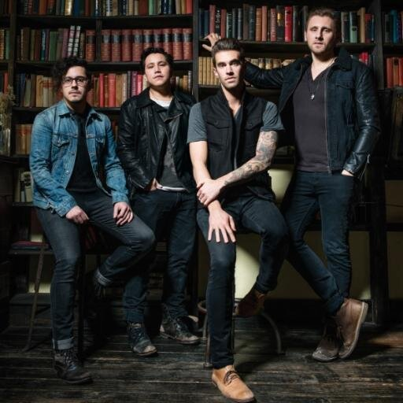
The Best Day of my Life
American Authors

Slide 14
The Best Day of my Life
I had a dream so big and loud
I jumped so high I touched the clouds
Wo-o-o-o-o-oh, wo-o-o-o-o-oh
I stretched my hands out to the sky
We danced with monsters through the night
Wo-o-o-o-o-oh, wo-o-o-o-o-oh
I'm never gonna look back
Woah, never gonna give it up
No, please don't wake me now
This is gonna be the best day of my life
My li-i-i-i-i-ife
This is gonna be the best day of my life
My li-i-i-i-i-ife
I howled at the moon with friends
And then the sun came crashing in
Wo-o-o-o-o-oh, wo-o-o-o-o-oh
But all the possibilities
No limits just epiphanies
Wo-o-o-o-o-oh, wo-o-o-o-o-oh
I'm never gonna look back
Woah, never gonna give it up
No, just don't wake me now
This is gonna be the best day of my life
My li-i-i-i-i-ife
This is gonna be the best day of my life
My li-i-i-i-i-ife

Slide 15
I hear it calling outside my window
I feel it in my soul (soul)
The stars were burning so bright
The sun was out 'til midnight
I say we lose control (control)
This is gonna be the best day of my life
My li-i-i-i-i-ife
This is gonna be the best day of my life
My li-i-i-i-i-ife
This is gonna be, this is gonna be, this is gonna be
The best day of my life
Everything is looking up, everybody up now
This is gonna be the best day of my life
My li-i-i-i-i-ife

Slide 16
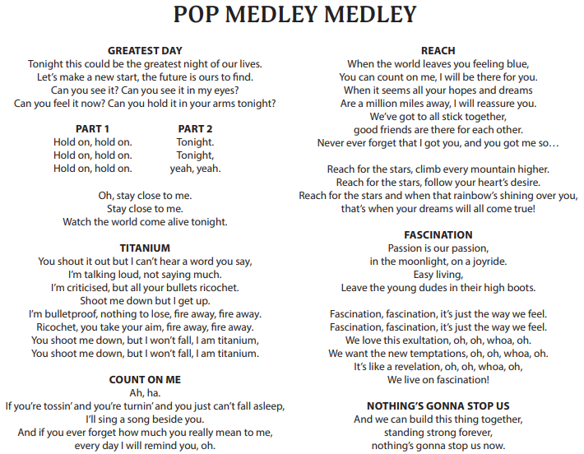

Slide 17
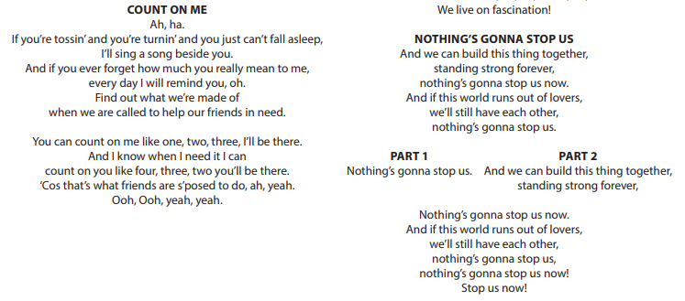

Slide 18
Power In Me https://www.youngvoices.co.uk/teacher-centre/resources/lyric-videos
When the race is nearly done, And I feel I can’t go on,
I know I can do something about it.
My heart will start to race,
My body find the motion,
And I will feel empowered from within.
I’ve got the power in me
You’ve got the power in you.
I’ve got the power, p p power,
got the power in me.
Nobody’s gonna hold me back,
Nobody’s gonna silence my words,
Nobody’s gonna close my mind,
I’ve got the power in me!
When someone’s needing help,
And the world just walks on by,
I know I can do something about it.
I’ll stand up for their rights,
My voice will find the words,
And I will feel empowered from within.
I’ve got the power in me
You’ve got the power in you.
I’ve got the power, p p power,
got the power in me.
Nobody’s gonna hold me back,
Nobody’s gonna silence my words,
Nobody’s gonna close my mind,
I’ve got the power in me!

Slide 19
When my mind is closing down,
And I’m lacking inspiration,
I know I can do something about it.
No one can stop me learning,
Create my dreams and future,
And I will feel empowered from within
I’ve got the power in me, You’ve got the power in you.
I’ve got the power, p p power, got the power in me.
Nobody’s gonna hold me back,
Nobody’s gonna silence my words,
Nobody’s gonna close my mind,
I’ve got the power in me!
Bridge section
We got the power
You got the power
I got the power the power in me! (Repeat)
We got the power Got the power!
You got the power Got the power!
I got the power, the power in me I got the power in me!
I’ve got the power in me, in me.
I’ve got the power in me, You’ve got the power in you.
I’ve got the power, p p power, got the power in me.
Nobody’s gonna hold me back,
Nobody’s gonna silence my words,
Nobody’s gonna close my mind,
I’ve got the power in me!

